Slide 1
Challenge :
Ayodhya Ram Temple
SQL Analysis
By: Gayatri Pradhan

Slide 2
TABLES
Deity
Temple
ConstructionPhase
Architecture
Donations
Events
TempleEvents

Slide 3
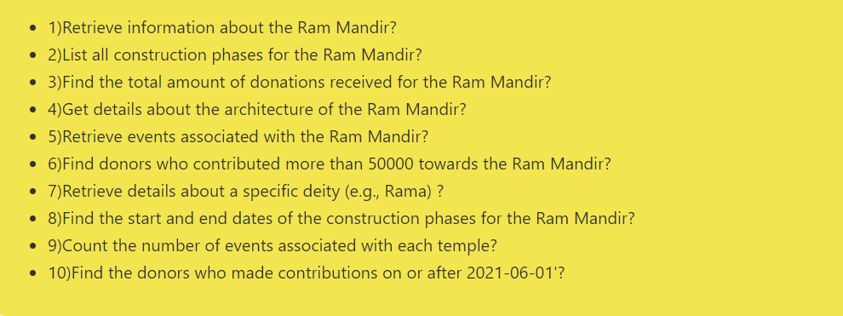
QUESTIONS

Slide 4
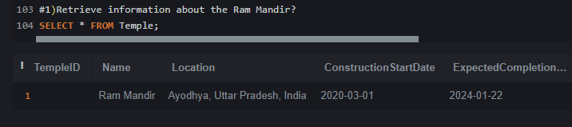
1) Retrieve information about the Ram Mandir?

Slide 5
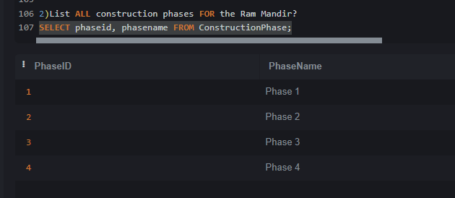
2) List all construction phases for the Ram Mandir?

Slide 6
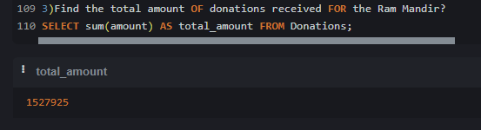
3) Find the total amount of donations received for the Ram Mandir?

Slide 7
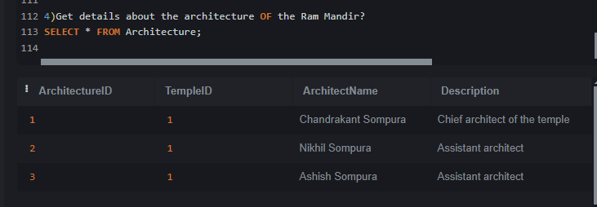
4) Get details about the architecture of the Ram Mandir?

Slide 8
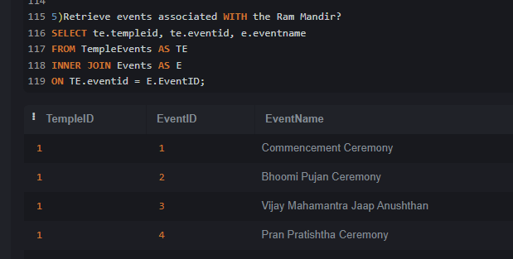
5) Retrieve events associated with the Ram Mandir?

Slide 9
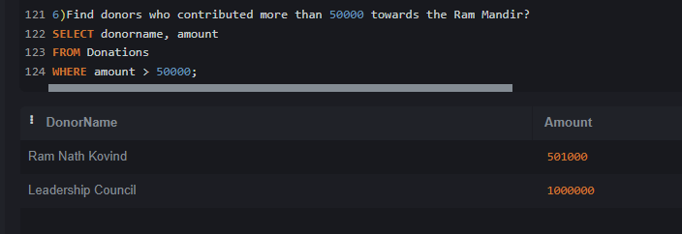
6) Find donors who contributed more than 50000 towards the Ram Mandir?

Slide 10
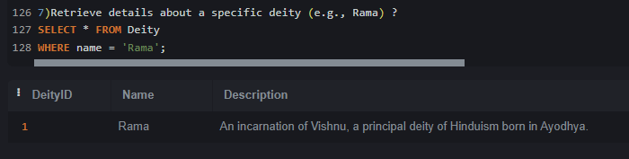
7) Retrieve details about a specific deity (e.g., Rama) ?

Slide 11
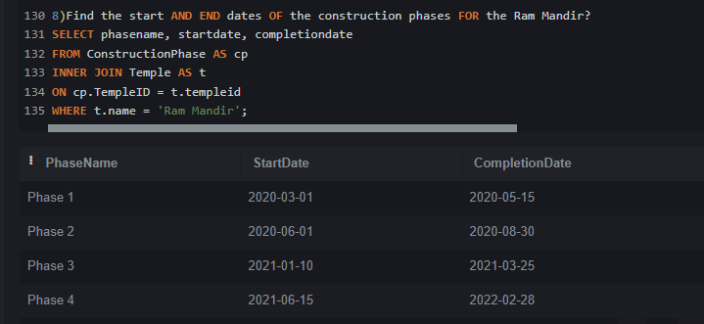
8) Find the start and end dates of the construction phases for the Ram Mandir?

Slide 12
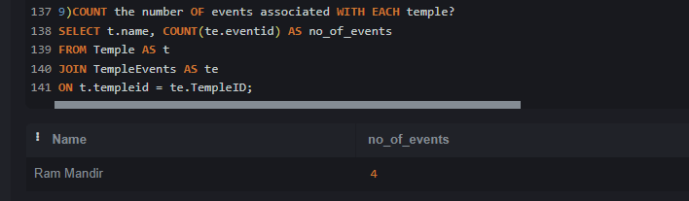
9) Count the number of events associated with each temple?

Slide 13
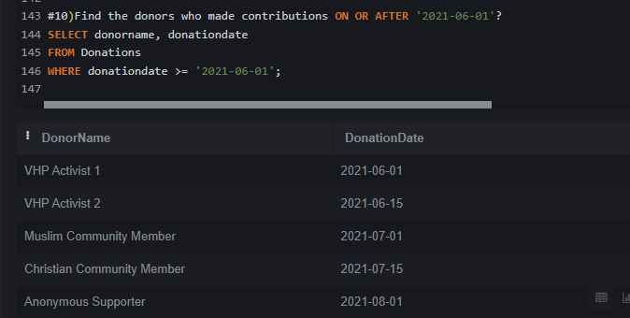
10) Find the donors who made contributions on or after ‘2021-06-01'?

Slide 14
THANK YOU

